Slide 1
How to move portfolios to a different Electronic Collection
Yoel Kortick
Senior Librarian

Slide 2

Introduction
Moving a single portfolio
Moving a set of portfolios
Agenda

Slide 3
Introduction

Slide 4
Introduction
In addition to this presentation see also
  Moving a Single Portfolio to a Different Electronic Collection
  Moving a Set of Portfolios to a Different Electronic Collection

Slide 5
Introduction
Both of the following can be moved from their current Electronic Collection to another Electronic Collection
  local portfolios
  portfolios activated from the Community Zone
The move can be done either
  one at a time
  by using a set of portfolios

Slide 6
Introduction
In a situation such as this the institution can link that portfolio from the community zone to a different bibliographic record.
That different bibliographic record may be one already catalogued in the institution.

Slide 7
Moving a single portfolio

Slide 8
Moving a single portfolio
In the example we are going to move portfolio “Convergence Marketing: Strategies for Reaching the New Hybrid Consumer”
  From Electronic Collection: iG Publishing: Pearson Education Taiwan
  To Electronic Collection: iG Publishing: National Taiwan University Press
Both Electronic Collections are linked to the Community Zone
When a portfolio which has been activated from the Community Zone moves from one collection to another it will:
  Become localized.
  Get unlinked from the Community Zone.

Slide 9
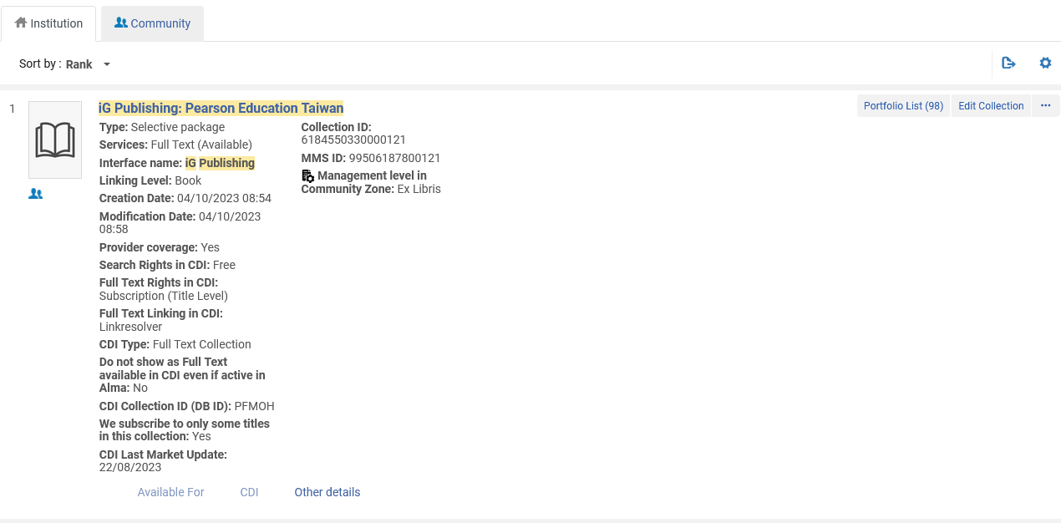
Moving a single portfolio
Find the Electronic Portfolio which we want to move and choose actions “move”.
For example, here we search for Electronic Collection “iG Publishing: Pearson Education Taiwan” and access the portfolio list.

Slide 10
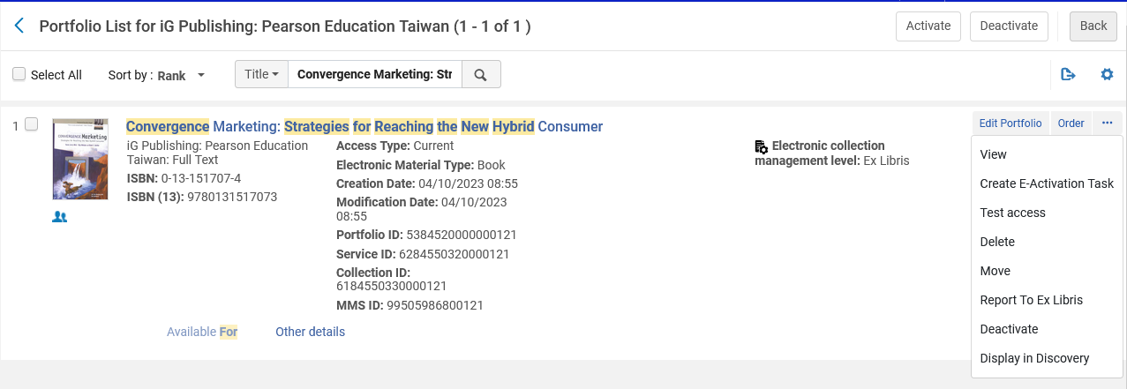
Moving a single portfolio
For the portfolio which we want to move (“Convergence Marketing: Strategies for Reaching the New Hybrid Consumer”) choose “actions > move”

Slide 11
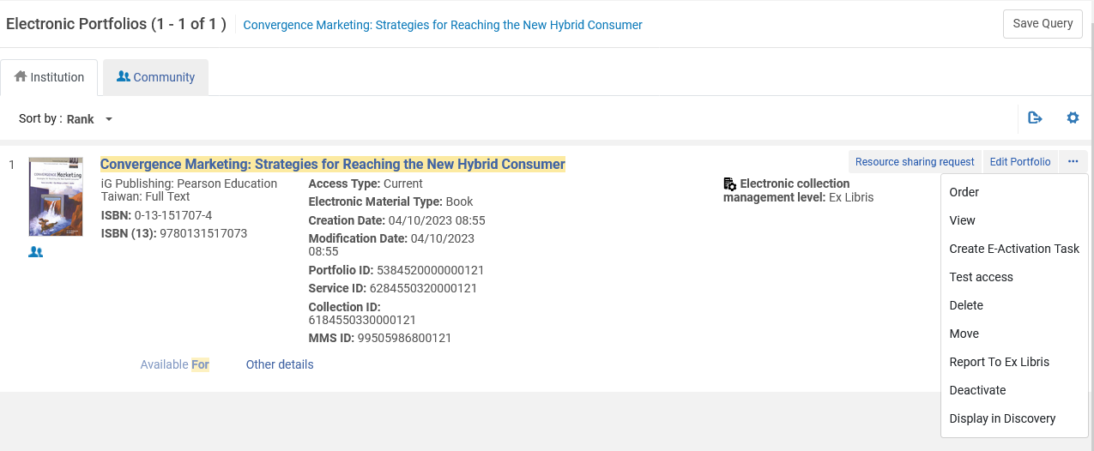
Moving a single portfolio
This can also be done by searching directly for this portfolio instead of accessing it from the portfolio list of the Electronic Collection.

Slide 12
Moving a single portfolio
After selecting “move” The “Move Portfolio” window opens.
In the “Destination Electronic Collection” field we will choose the collection to which we want to move the portfolio.
Note the statement, as per what was already explained here: “Please note: a CZ activated portfolio that moves from one collection to another will be localized and get unlinked from CZ.”

Slide 13
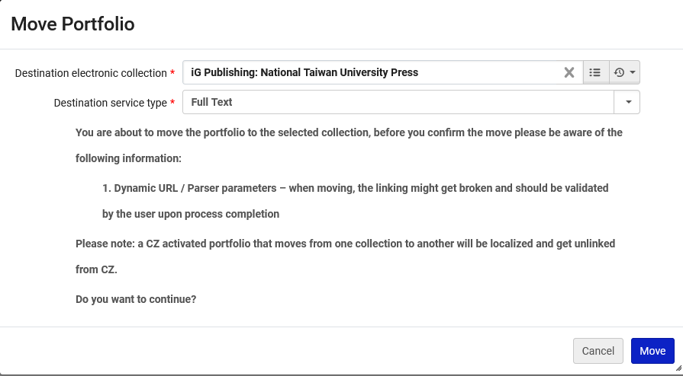
Moving a single portfolio
In the “Destination Electronic Collection” field we have chosen the collection to which we want to move the portfolio.
We will now click “Move”

Slide 14
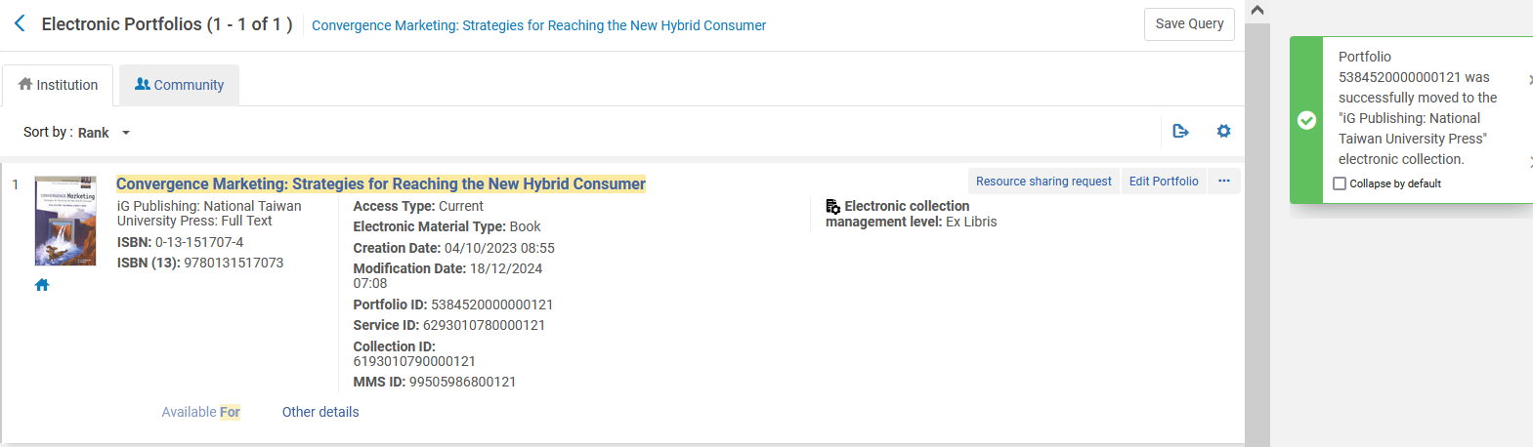
Moving a single portfolio
The Electronic Portfolio has moved from Electronic Collection “iG Publishing: Pearson Education Taiwan” to Electronic Collection: iG Publishing: National Taiwan University Press and become localized (no longer linked to the Community Zone)
We will now click “Move”

Slide 15
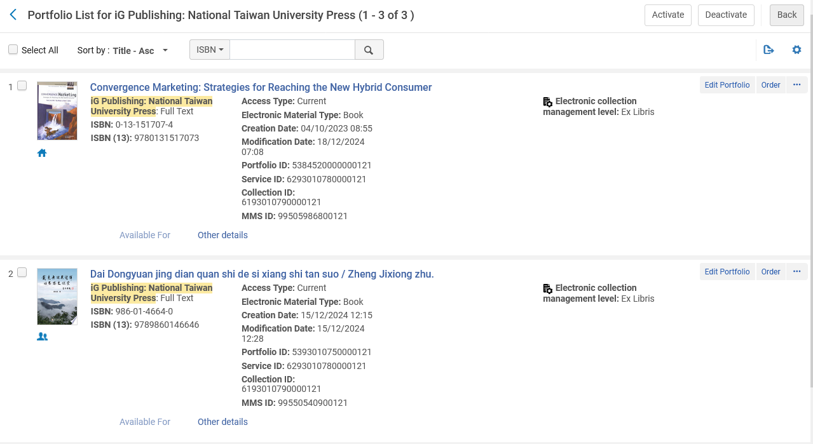
Moving a single portfolio
“Convergence Marketing: Strategies for Reaching the New Hybrid Consumer” is in Electronic Collection “iG Publishing: National Taiwan University Press” and is a local portfolio
Local portfolio
CZ portfolio

Slide 16
Moving a set of portfolios

Slide 17
Moving a set of portfolios
The steps to move a set of portfolios from Electronic Collection A to Electronic Collection B are as follows:
Create a set of portfolios which are in Electronic Collection A
Go to the Portfolios tab of the Electronic Service Editor of Electronic Collection A
Select option “Move Set of Portfolios”.
Enter the set name and destination Electronic Collection (Electronic Collection B)
Select Move. A job to move the portfolios runs.
Note that in step 4 above it is possible to choose a set which has portfolios for “Electronic Collection A” and also a different Electronic Collection” all in the same set. The job will only move portfolios for “Electronic Collection A”. The job only moves portfolios in the Electronic Collection for which the electronic service from which the job is run is associated.

Slide 18
Moving a set of portfolios
Note also that as was the case when we moved a single portfolio:
When a portfolio which has been activated from the Community Zone moves from one collection to another it will
  Become localized
  Get unlinked from the Community Zone.

Slide 19
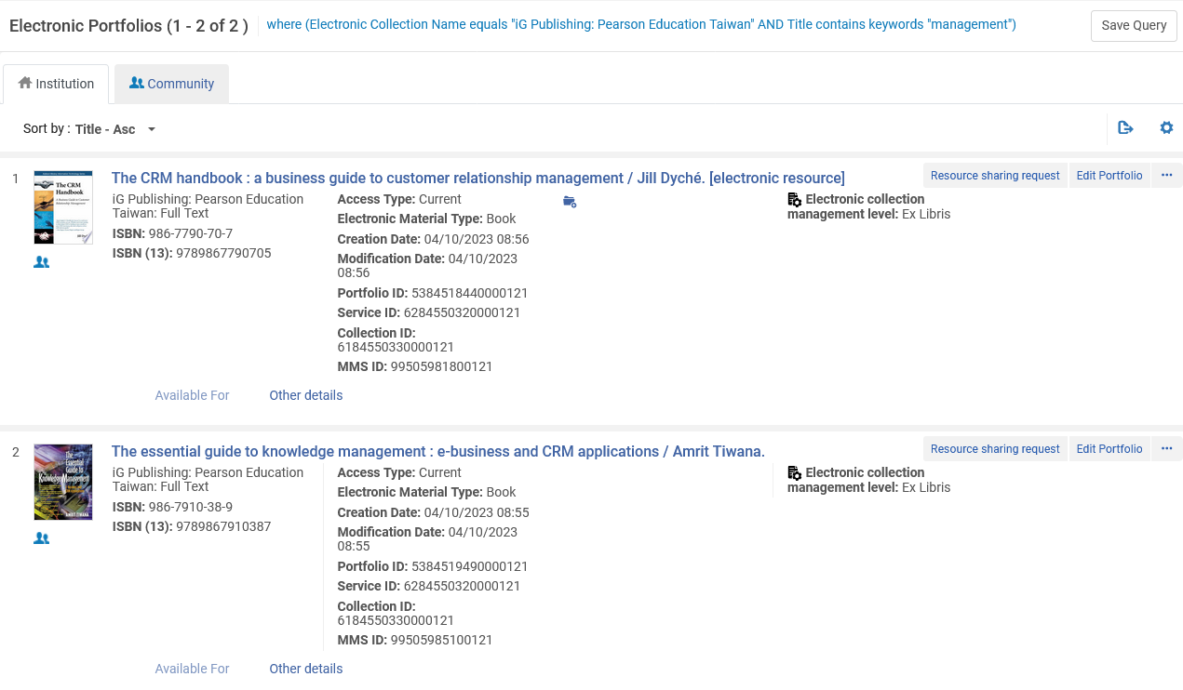
Moving a set of portfolios
Here we are making a set of 2 portfolios which have “Management” in the title and are part of Electronic Collection “iG Publishing: Pearson Education Taiwan”

Slide 20
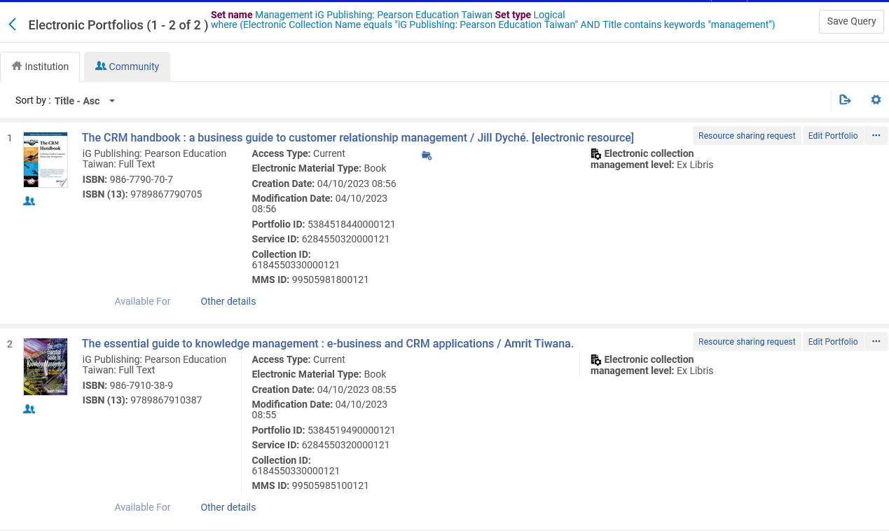
Moving a set of portfolios
The set is called “Management iG Publishing: Pearson Education Taiwan”

Slide 21
Moving a set of portfolios
We will move the 2 portfolios in this set which are in Electronic Collection “iG Publishing: Pearson Education Taiwan” to Electronic Collection “iG Publishing: National Taiwan University Press”
We will search for Electronic Collection “iG Publishing: Pearson Education Taiwan” (the set from which the portfolios will move) and then access the portfolios tab of the electronic service.
We can directly access the portfolios tab of the electronic service by choosing “Edit full text portfolios”

Slide 22
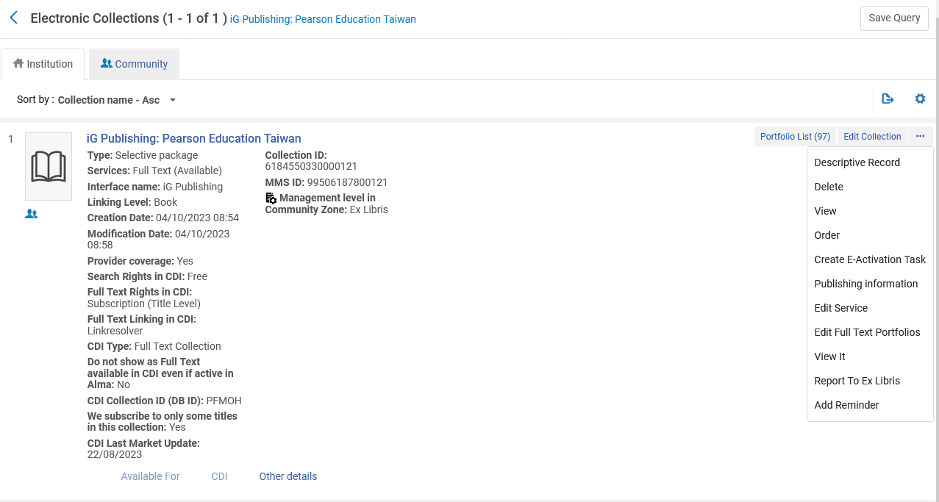
Moving a set of portfolios
We can directly access the portfolios tab of the electronic service by choosing “Edit full text portfolios”

Slide 23
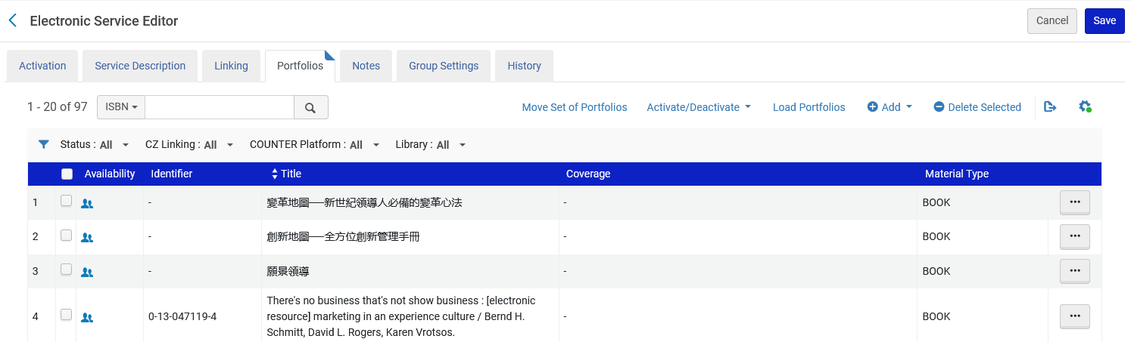
Moving a set of portfolios
From the “Portfolios” tab of the electronic service editor we will choose “Move Set of Portfolios”

Slide 24
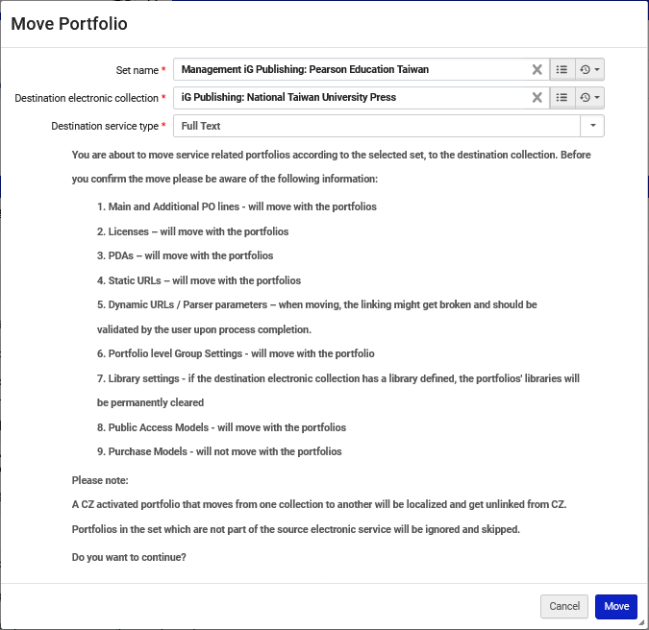
Moving a set of portfolios
Choose the set and desired destination Electronic Collection and click “Move”
The set of portfolios in Electronic Collection “iG Publishing: Pearson Education Taiwan”
Move to Electronic Collection “iG Publishing: National Taiwan University Press”

Slide 25

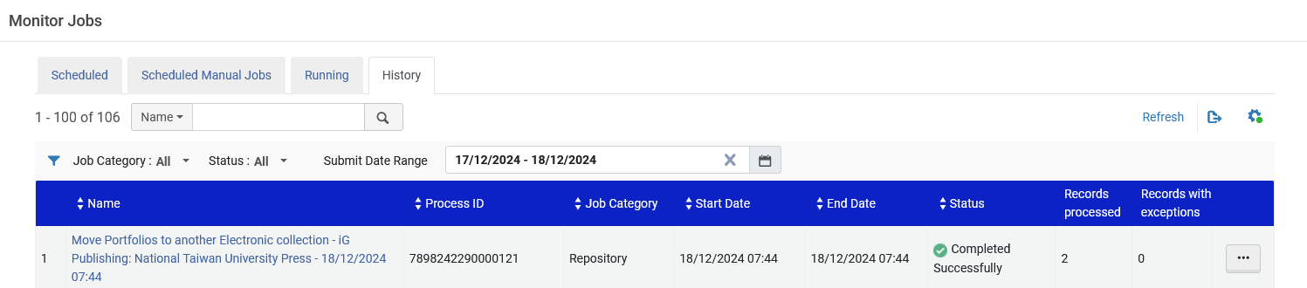
Moving a set of portfolios
The “Move portfolios job” is submitted.

Slide 26
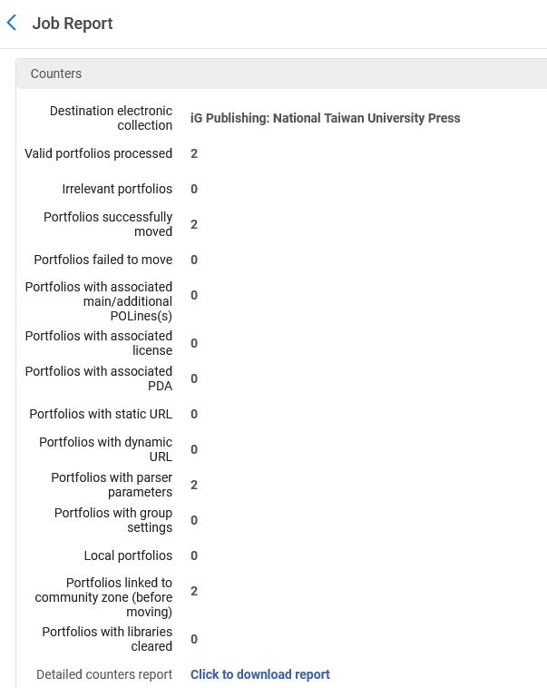
Moving a set of portfolios
We can see from the job report that the two portfolios have moved to Electronic Collection “iG Publishing: National Taiwan University Press”.

Slide 27
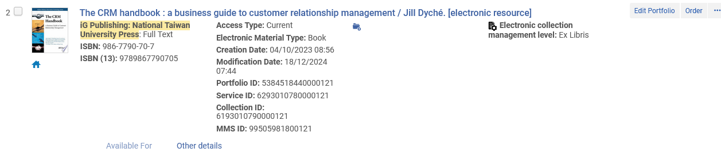
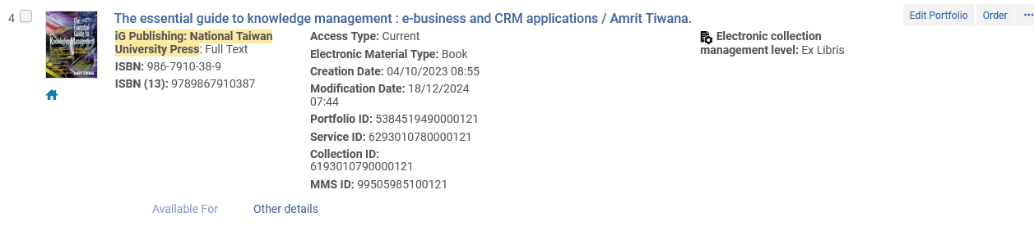
Moving a set of portfolios
The two portfolios from the set have moved to Electronic Collection “iG Publishing: National Taiwan University Press” and become localized.
The portfolios are no longer linked to the Community Zone

Slide 28
xxx@exlibrisgroup.com

